Slide 1
t-SNE Pedagogical Report
Group U4 - Aksshat Gupta, Yuxiao Li, Miles Harrison

Slide 2
Introduction: High-Dim Data Visualization
High dimensional data is difficult to analyze visually. By reducing dimensionality to a 2D or 3D plot, we are better able to analyze it visually
Current Methods:
Linear Methods such as PCA, LDA, and MDS perform poorly when used on complex high dimensional datasets
Nonlinear methods such as Sammon mapping, Isomap and LLE fail to capture both local and global structure
=> t-SNE

Slide 3
“Visualizing Data Using t-SNE”
Authors:
Laurens van der Maaten;
Geoffrey Hinton
Publication:
Journal of Machine Learning Research 2008, 2579-2605

Slide 4
t-SNE
Nonlinear technique for high-dimensional data visaulization in 2D or 3D
Variation of SNE (2002)
cost function is easier to optimize
solves the crowding problem
Retains both global and local structure of the data
Better visualization
Drawbacks:
quadratic time and memory complexity
difficult hyperparameter selection

Slide 5
t-SNE: Algorithm Explanation
Compute high-dimensional affinities P among the datapoints
Compute low-dimensional affinities Q
Optimize Q with Kullback-Leibler divergence
Kullback-Leibler divergence measures expected log difference between two probability distributions

Slide 6

t-SNE: Algorithm Explanation
Compute high-dimensional affinities P among the datapoints:
For all datapoints x_{i}, compute P_{i|j} for all datapoints x_{j} :
P_{i|j}: the conditional probability that x_{i} would pick x_{j} as its neighbor
determined in proportion to x_{j}’s probability density under a Gaussian centered at x_{i}

Slide 7
t-SNE: Algorithm Explanation
Compute high-dimensional affinities P among the datapoints:
For all datapoints x_{i}, compute P_{i|j} for all datapoints x_{j} :
P_{i|j}: the conditional probability that x_{i} would pick x_{j} as its neighbor
determined in proportion to x_{j}’s probability density under a Gaussian centered at x_{i}
determined by “perplexity”

Slide 8


t-SNE: Algorithm Explanation
Compute high-dimensional affinities P among the datapoints:
Perplexity(hyperparameter, usually between 5 and 50):
a measure of the number of neighbors
Given a probability distribution P_{i}, its perplexity is calculated by:
Shannon Entropy

Slide 9
t-SNE: Algorithm Explanation
Compute high-dimensional affinities P among the datapoints:
Perplexity(hyperparameter, usually between 5 and 50):
a measure of the number of neighbors
Given a perplexity Perp, we determine the variance var_{i} that produce a distribution P_{i} with the given Perp using binary search.

Slide 10
t-SNE: Algorithm Explanation
Compute high-dimensional affinities P among the datapoints:
After having computed all conditional probability P_{i|j} , calculate the high-dimensional affinity P where P_{i,j} = (P_{i|j} + P_{j|i}) / 2

Slide 11
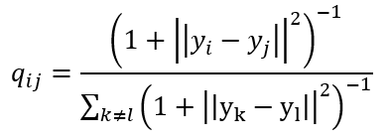
t-SNE: Algorithm Explanation
2) Compute low-dimensional affinities Q:
calculate Q using a Student-t distribution:
Student-t distribution:
heavy-tailed
eliminates unwanted attractive forces among dissimilar datapoints

Slide 12
t-SNE: Algorithm Explanation
3) Optimize Q using Kullback-Leibler divergence:
If we preserve the structures successfully, P_{i,j} and Q_{i,j} would be very similar
Kullback-Leibler divergence measures expected log difference between two probability distributions

Slide 13


t-SNE: Algorithm Explanation
3) Optimize Q using Kullback-Leibler divergence:
Cost Function:
Gradient:

Slide 14
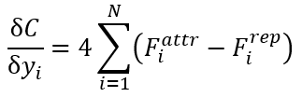
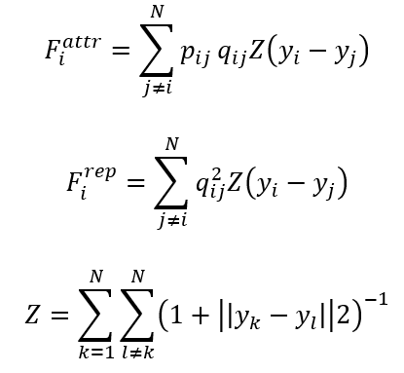
t-SNE: Algorithm Explanation
3) Optimize Q using Kullback-Leibler divergence:
Gradient (another form):

Slide 15
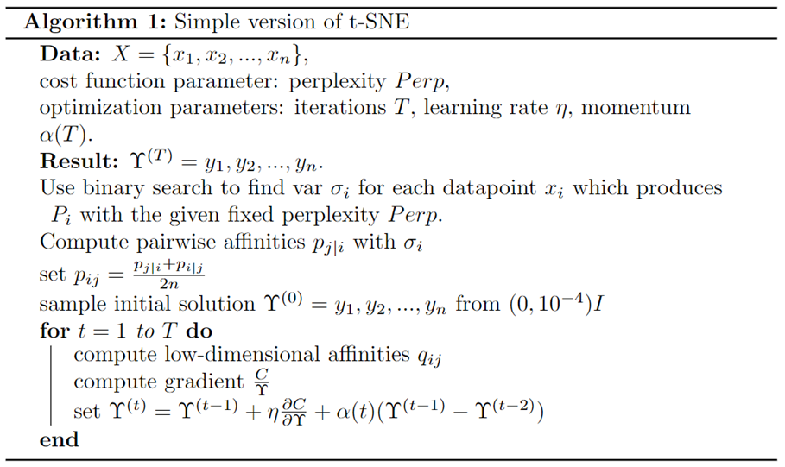
t-SNE: Simple Algorithm

Slide 16
t-SNE: Cost & Drawbacks
Quadratic time and memory complexity
Slower compared to similar algorithms like PCA, LLE, Isomap
Also needs to be run with multiple sets of hyperparameters
In practice for large datasets use random walks on neighborhood graphs to select <= 10k data points
Useful for datasets with over 10,000 data points

Slide 17
t-SNE: Performance Guarantees
t-SNE provides no performance guarantees
Many choices are made by looking at the model output
Hyperparameters are chosen by looking at the resulting plots
To reach convergence, t-SNE is run until it appears stable

Slide 18
t-SNE: Empirical Evaluation
Implement the following steps:
Dataset: fashion_mnist
Preprocess: Normalize, Flatten, Scale
Apply t-SNE at perplexity of 50 and learning rate at 200
Visualize the results
Repeat steps 3 and 4 to look at various different perplexity and learning rates along with the other hyperparameters.
For comparison with other algorithms just replace step 3 with PCA, Isomap, or LLE model

Slide 19
t-SNE: Comparison
t-SNE:
t-SNE is very dependent upon it’s hyperparameters
It becomes complex very quickly with more datapoints
Other algorithms:
PCA cannot capture non-linear relationships
Isomap can be affected by noise or outliers
LLE only considers local relationships, it cannot capture the global structure of the data

Slide 20
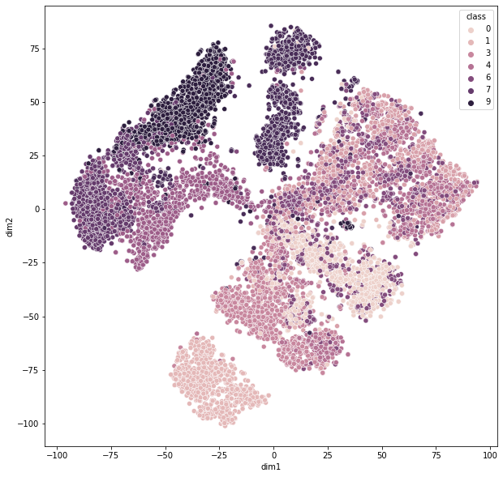
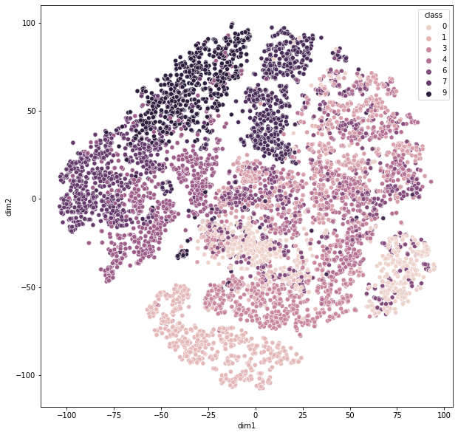
t-SNE: Differences between Hyperparameters
perplexity=50, learning_rate=200, n_iter=2000
perplexity=10, learning_rate=200

Slide 21
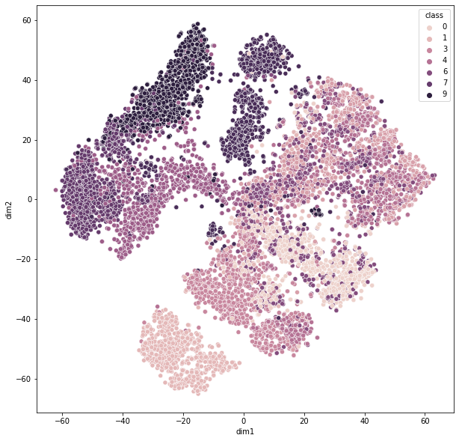
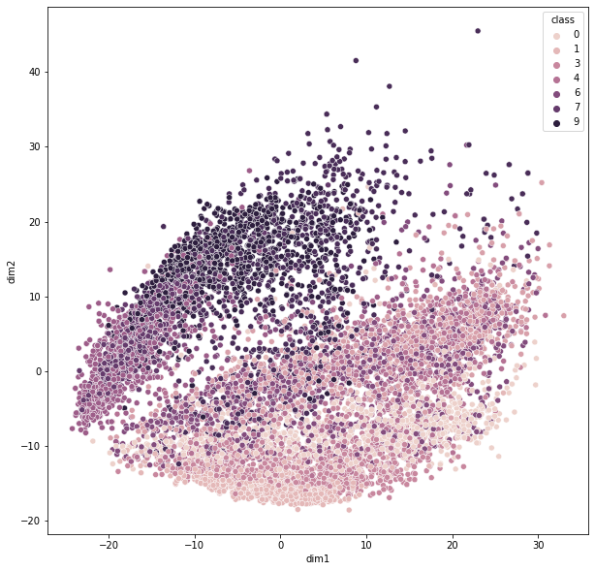
t-SNE: Results from the Evaluation
t-SNE - baseline (perplexity=50, learning_rate=200)
PCA

Slide 22
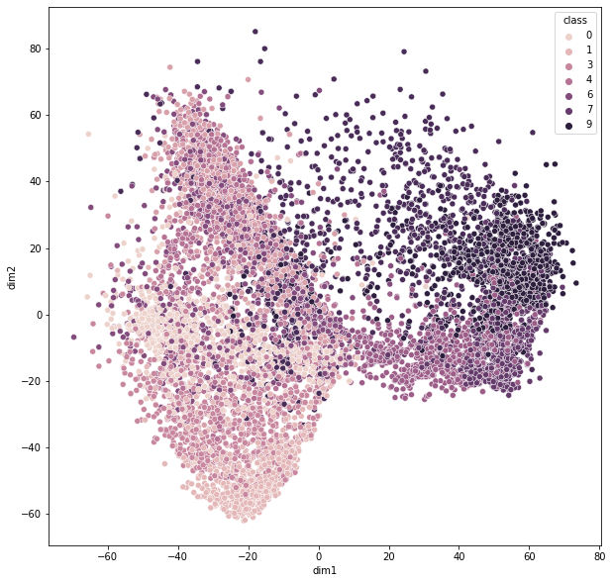
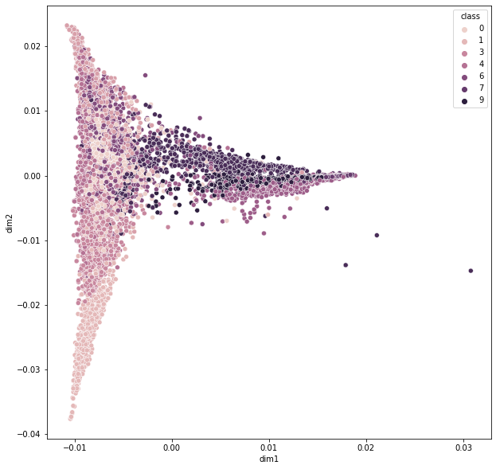
t-SNE: Results from the Evaluation
Isomap
LLE

Slide 23
t-SNE: Conclusion
“Visualizing Data using t-SNE” compares t-SNE to existing methods for visualizing data in high dimensions
t-SNE has many advantages over other visualization methods
Retains both local and global structure
Can outperform existing state of the art techniques for visualizing some real-world data sets
t-SNE also has some weaknesses
Quadratic run time and memory complexity
Unclear how well it performs at reducing to dimensionality d when d > 3
Cost function is not convex, relies on good hyperparameter selection

